Slide 1

openAI

Slide 2
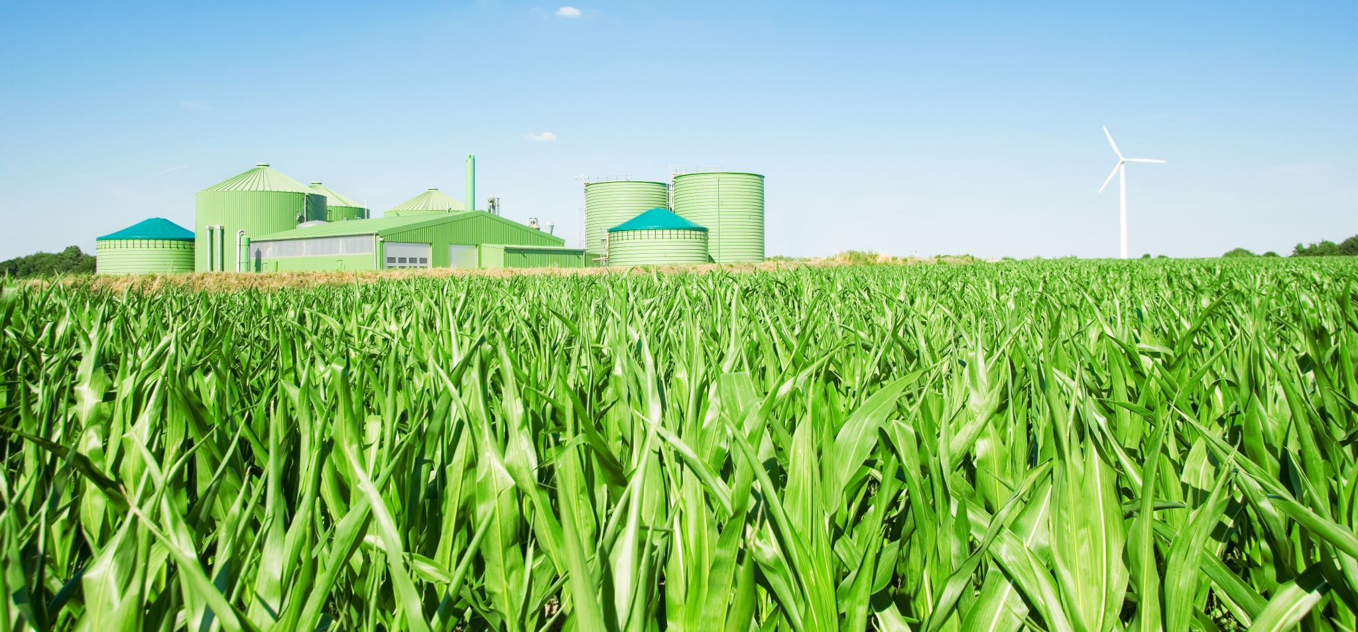
openAI Image Generation

Slide 3

Image Generation
The Images API provides three methods for interacting with images:
Creating images from scratch based on a text prompt
Creating edits of an existing image based on a new text prompt
Creating variations of an existing image

Slide 4
Creating images from scratch based on a text prompt
The image generations endpoint allows you to create an original image given a text prompt. Generated images can have a size of 256x256, 512x512, or 1024x1024 pixels. Smaller sizes are faster to generate. You can request 1-10 images at a time using the n parameter.
response = openai.Image.create(
prompt="a white siamese cat",
n=1,
size="1024x1024"
)
image_url = response['data'][0]['url']

Slide 5


Creating images from scratch based on a text prompt
Import openai
openai.api_key = “xxxxxxxxxxxx”
response = openai.Image.create(
prompt = "a lady in a professional dress in front of office building",
n = 2,
size = "256x256" )
import requests
import matplotlib.pyplot as plt
image_urls = [im['url'] for im in response['data’]]
for url in image_urls:
img_content = requests.get(url).content
name = "img"+str(image_urls.index(url))+".jpg"
with open(name,"wb") as file:
file.write(img_content)
im = plt.imread(name)
plt.imshow(im)
plt.axis(False)
plt.show()

Slide 6
Creating edits of an existing image based on a new text prompt
The image edits endpoint allows you to edit and extend an image by uploading a mask.
The transparent areas of the mask indicate where the image should be edited, and the prompt should describe the full new image, not just the erased area.
The uploaded image and mask must both be square PNG images less than 4MB in size, and also must have the same dimensions as each other.
The non-transparent areas of the mask are not used when generating the output, so they don’t necessarily need to match the original image like the example above.
response = openai.Image.create_edit(
image=open("sunlit_lounge.png", "rb"),
mask=open("mask.png", "rb"),
prompt="A sunlit indoor lounge area with a pool containing a flamingo",
n=1,
size="1024x1024"
)
image_url = response['data'][0]['url’]

Slide 7



Creating edits of an existing image based on a new text prompt
Import openai
openai.api_key = “xxxxxxxxxxxx”
response = openai.Image.create_edit(
image = open("imimg.png",'rb'),
mask = open("immask.png",'rb'),
prompt = "a professional lady standing in front of an office building with a man",
n = 1,
size = "1024x1024“ )
import requests
import matplotlib.pyplot as plt
image_urls = [im['url'] for im in response['data']]
for url in image_urls:
img_content = requests.get(url).content
name = "img"+str(image_urls.index(url))+".jpg"
with open(name,"wb") as file:
file.write(img_content)
im = plt.imread(name)
plt.imshow(im)
plt.axis(False)
plt.show()
Input Image
Input Image mask
Output Image

Slide 8
Creating variations of an existing image
The image variations endpoint allows you to generate a variation of a given image.
Similar to the edits endpoint, the input image must be a square PNG image less than 4MB in size.
response = openai.Image.create_variation(
image=open("corgi_and_cat_paw.png", "rb"),
n=1,
size="1024x1024"
)
image_url = response['data'][0]['url’]

Slide 9






Creating variations of an existing image
Import openai
openai.api_key = “xxxxxxxxxxxx”
response = openai.Image.create_variation(
image = open("imimg.png",'rb'),
n=6,
size = "1024x1024" )
import requests
import matplotlib.pyplot as plt
image_urls = [im['url'] for im in response['data']]
for url in image_urls:
img_content = requests.get(url).content
name = "img"+str(image_urls.index(url))+".jpg"
with open(name,"wb") as file:
file.write(img_content)
im = plt.imread(name)
plt.imshow(im)
plt.axis(False)
plt.show()
Input Image
Output Images

Slide 10

openAI Audio

Slide 11

Audio with openAI
The speech to text API provides two endpoints, transcriptions and translations, based on our state-of-the-art open source large-v2 Whisper model. They can be used to:
Transcribe audio into whatever language the audio is in.
Translate and transcribe the audio into english.
File uploads are currently limited to 25 MB and the following input file types are supported: mp3, mp4, mpeg, mpga, m4a, wav, and webm.

Slide 12
Transcribe audio
The transcriptions API takes as input the audio file you want to transcribe and the desired output file format for the transcription of the audio.
It currently supports multiple input and output file formats.
# Note: you need to be using OpenAI Python v0.27.0 for the code below to work
import openai
openai.api_key = “xxxxxxxxxxxx”
audio_file= open("/path/to/file/audio.mp3", "rb")
transcript = openai.Audio.transcribe("whisper-1", audio_file)

Slide 13
Translate and transcribe the audio into english
The translations API takes as input the audio file in any of the supported languages and transcribes, if necessary, the audio into English.
This differs from Transcriptions endpoint since the output is not in the original input language and is instead translated to English text.
# Note: you need to be using OpenAI Python v0.27.0 for the code below to work
import openai
openai.api_key = “xxxxxxxxxxxx”
audio_file= open("/path/to/file/german.mp3", "rb")
transcript = openai.Audio.translate("whisper-1", audio_file)

Slide 14

Content Moderation

Slide 15

Moderation API
The moderations endpoint is a tool you can use to check whether content complies with OpenAI's usage policies.
Developers can thus identify content that our usage policies prohibits and take action, for instance by filtering it.
The moderation endpoint is free to use when monitoring the inputs and outputs of OpenAI APIs. openAI currently disallow other use cases.
Accuracy may be lower on longer pieces of text. For higher accuracy, try splitting long pieces of text into smaller chunks each less than 2,000 characters.

Slide 16
Moderation Categories
CATEGORY | DESCRIPTION
hate | Content that expresses, incites, or promotes hate based on race, gender, ethnicity, religion, nationality, sexual orientation, disability status, or caste. Hateful content aimed at non-protected groups (e.g., chess players) is harrassment.
hate/threatening | Hateful content that also includes violence or serious harm towards the targeted group based on race, gender, ethnicity, religion, nationality, sexual orientation, disability status, or caste.
harassment | Content that expresses, incites, or promotes harassing language towards any target.
harassment/threatening | Harassment content that also includes violence or serious harm towards any target.
self-harm | Content that promotes, encourages, or depicts acts of self-harm, such as suicide, cutting, and eating disorders.
self-harm/intent | Content where the speaker expresses that they are engaging or intend to engage in acts of self-harm, such as suicide, cutting, and eating disorders.
self-harm/instructions | Content that encourages performing acts of self-harm, such as suicide, cutting, and eating disorders, or that gives instructions or advice on how to commit such acts.
sexual | Content meant to arouse sexual excitement, such as the description of sexual activity, or that promotes sexual services (excluding sex education and wellness).
sexual/minors | Sexual content that includes an individual who is under 18 years old.
violence | Content that depicts death, violence, or physical injury.
violence/graphic | Content that depicts death, violence, or physical injury in graphic detail.

Slide 17
Moderation API
{
"id": "modr-XXXXX",
"model": "text-moderation-005",
"results": [
{
"flagged": true,
"categories": {
"sexual": false,
"hate": false,
"harassment": false,
"self-harm": false,
"sexual/minors": false,
"hate/threatening": false,
"violence/graphic": false,
"self-harm/intent": false,
"self-harm/instructions": false,
"harassment/threatening": true,
"violence": true,
},
"category_scores": {
"sexual": 1.2282071e-06,
"hate": 0.010696256,
"harassment": 0.29842457,
"self-harm": 1.5236925e-08,
"sexual/minors": 5.7246268e-08,
"hate/threatening": 0.0060676364,
"violence/graphic": 4.435014e-06,
"self-harm/intent": 8.098441e-10,
"self-harm/instructions": 2.8498655e-11,
"harassment/threatening": 0.63055265,
"violence": 0.99011886,
}
}
]
}
import openai
openai.api_key = “xxxxxxxxxxxx”
response = openai.Moderation.create(
input="Sample text goes here"
)
output = response["results"][0]

Slide 18
openAI Embeddings

Slide 19
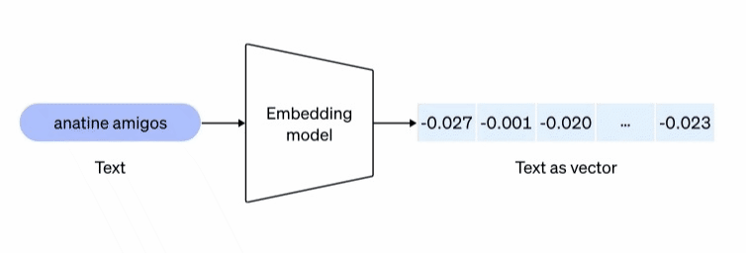
Embeddings
Embeddings are numerical representations of concepts converted to number sequences, which make it easy for computers to understand the relationships between those concepts. Since the initial launch of the OpenAI /embeddings endpoint, many applications have incorporated embeddings to personalize, recommend, and search content.

Slide 20
Embeddings
OpenAI’s text embeddings measure the relatedness of text strings. Embeddings are commonly used for:
Search (where results are ranked by relevance to a query string)
Clustering (where text strings are grouped by similarity)
Recommendations (where items with related text strings are recommended)
Anomaly detection (where outliers with little relatedness are identified)
Diversity measurement (where similarity distributions are analyzed)
Classification (where text strings are classified by their most similar label)
An embedding is a vector (list) of floating point numbers. The distance between two vectors measures their relatedness. Small distances suggest high relatedness and large distances suggest low relatedness.

Slide 21
Embeddings
To get an embedding, send your text string to the embeddings API endpoint along with a choice of embedding model ID (e.g., text-embedding-ada-002). The response will contain an embedding, which you can extract, save, and use.
import openai
openai.api_key = “xxxxxxxxxxxx”
response = openai.Embedding.create(
input="Your text string goes here",
model="text-embedding-ada-002"
)
embeddings = response['data'][0]['embedding’]

Slide 22
Embeddings models
OpenAI offers one second-generation embedding model (denoted by -002 in the model ID) and 16 first-generation models (denoted by -001 in the model ID).
MODEL GENERATION | TOKENIZER | MAX INPUT TOKENS | KNOWLEDGE CUTOFF
V2 | cl100k_base | 8191 | Sep 2021
V1 | GPT-2/GPT-3 | 2046 | Aug 2020

Slide 23
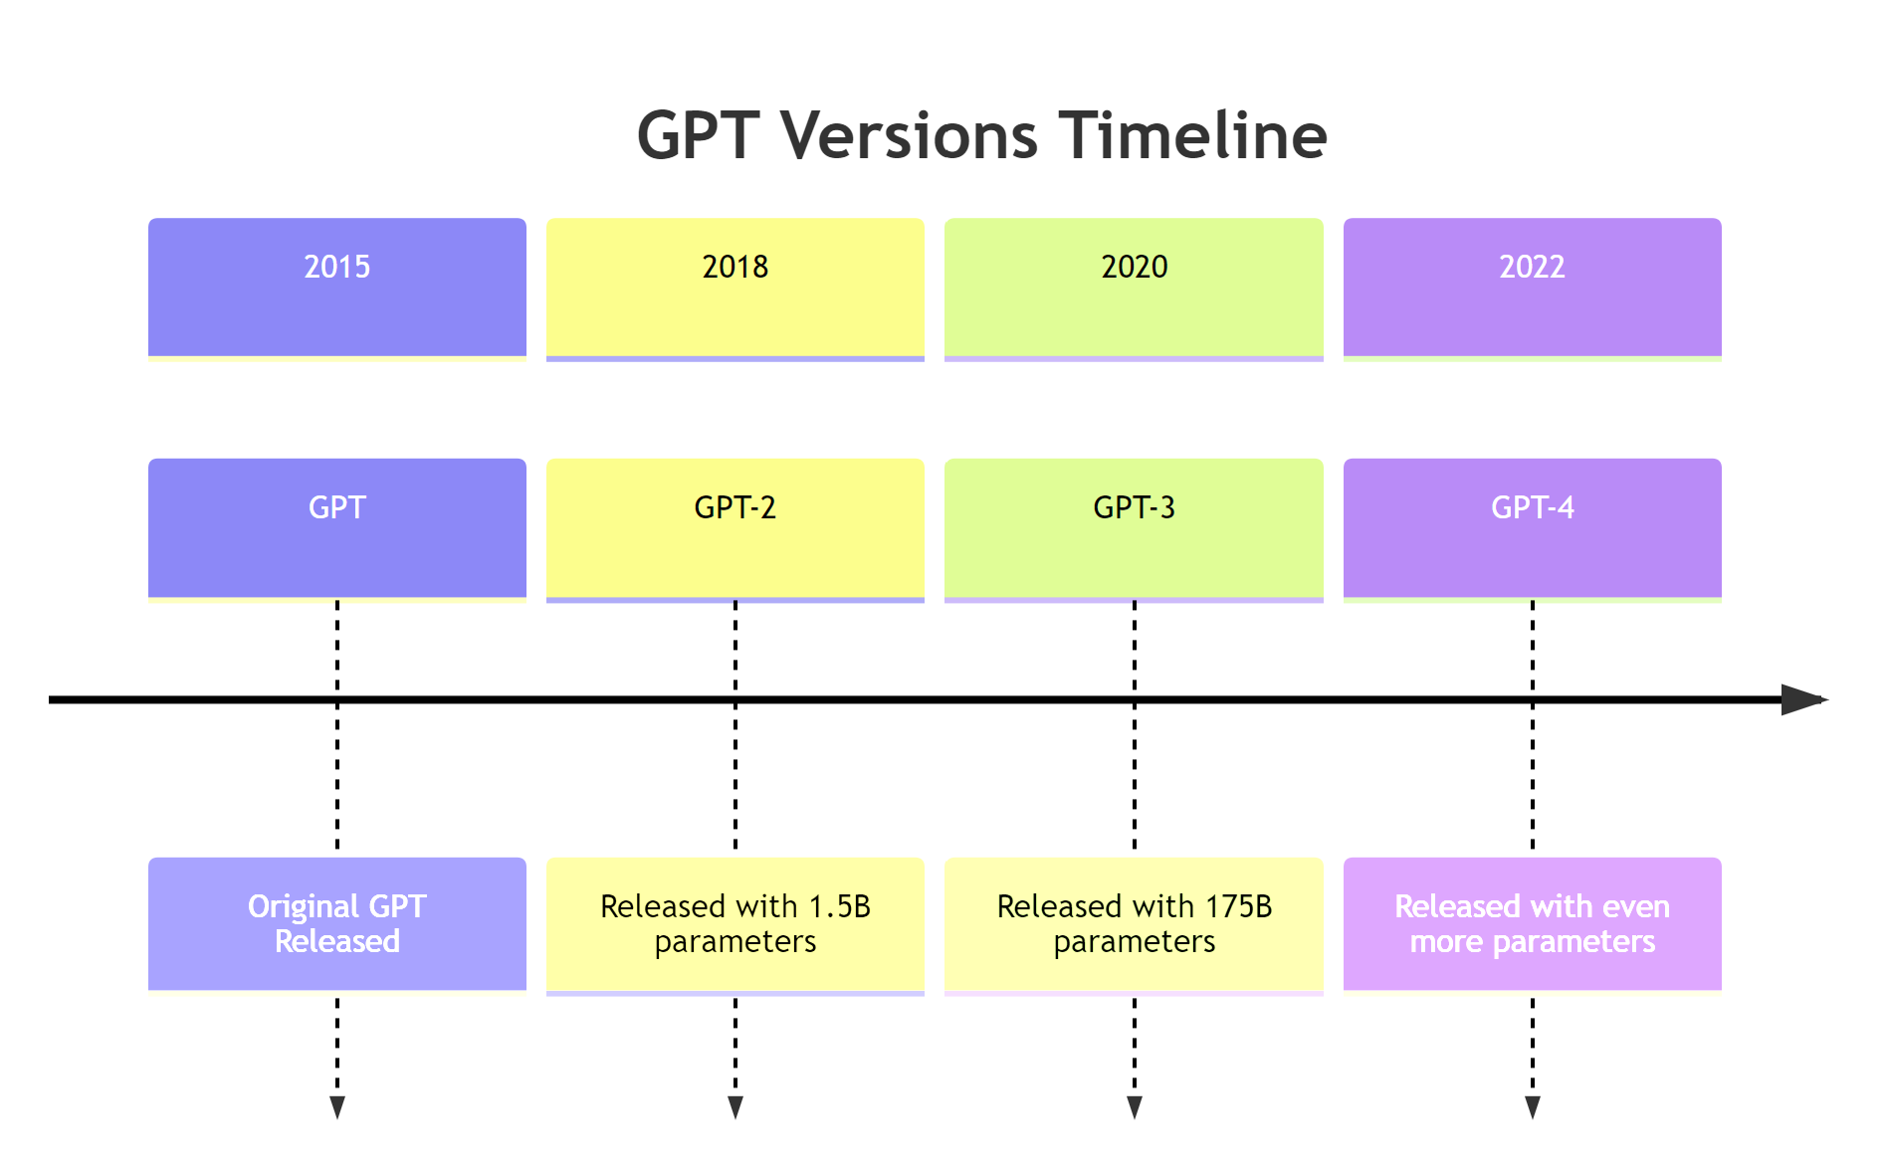

Slide 24
Rate Limits
A rate limit is a restriction that an API imposes on the number of times a user or client can access the server within a specified period of time.

Slide 25
Why do we have rate limits?
Rate limits are a common practice for APIs, and they're put in place for a few different reasons:
They help protect against abuse or misuse of the API.
For example, a malicious actor could flood the API with requests in an attempt to overload it or cause disruptions in service. By setting rate limits, OpenAI can prevent this kind of activity.
Rate limits help ensure that everyone has fair access to the API.
If one person or organization makes an excessive number of requests, it could bog down the API for everyone else. By throttling the number of requests that a single user can make, OpenAI ensures that the most number of people have an opportunity to use the API without experiencing slowdowns.
Rate limits can help OpenAI manage the aggregate load on its infrastructure.
If requests to the API increase dramatically, it could tax the servers and cause performance issues. By setting rate limits, OpenAI can help maintain a smooth and consistent experience for all users.

Slide 26
What are the rate limits for openAI API? (Sep23)
 | REQUESTS PER DAY (RPD) | REQUESTS PER MINUTE (RPM) | TOKENS PER MINUTES (TPM)
Text & Embedding | --- | 3,500 RPM | 350,000 TPM
Chat | --- | 3,500 RPM | 90,000 TPM
GPT-3.5-Turbo-16K | --- | 2,000 RPM | 180,000 TPM
Image | --- | 50 images / min | ---
Audio | --- | 50 | ---
Fine-tuning | 24 jobs per day | 1 job at a time per model | ---
Edit (Deprecated) | --- | 20 | 150,000 TPM
https://platform.openai.com/docs/guides/rate-limits/overview

Slide 27
GPT Best practices: Write clear instructions
GPTs can’t read your mind. If outputs are too long, ask for brief replies. If outputs are too simple, ask for expert-level writing. If you dislike the format, demonstrate the format you’d like to see. The less GPTs have to guess at what you want, the more likely you’ll get it.
Include details in your query to get more relevant answers
1
Ask the model to adopt a persona
2
Use delimiters to clearly indicate distinct parts of the input
3
Specify the steps required to complete a task
4
Provide examples
5
Specify the desired length of the output
6

Slide 28
GPT Best practices: Provide reference text
GPTs can confidently invent fake answers, especially when asked about esoteric topics or for citations and URLs. In the same way that a sheet of notes can help a student do better on a test, providing reference text to GPTs can help in answering with fewer fabrications.
Instruct the model to answer using a reference text
Instruct the model to answer with citations from a reference text

Slide 29
GPT Best practices: Split complex tasks into simpler subtasks
Just as it is good practice in software engineering to decompose a complex system into a set of modular components, the same is true of tasks submitted to GPTs. Complex tasks tend to have higher error rates than simpler tasks. Furthermore, complex tasks can often be re-defined as a workflow of simpler tasks in which the outputs of earlier tasks are used to construct the inputs to later tasks.
Use intent classification to identify the most relevant instructions for a user query
For dialogue applications that require very long conversations, summarize or filter previous dialogue
Summarize long documents piecewise and construct a full summary recursively

Slide 30
GPT Best practices: Give GPTs time to "think"
If asked to multiply 17 by 28, you might not know it instantly, but can still work it out with time. Similarly, GPTs make more reasoning errors when trying to answer right away, rather than taking time to work out an answer. Asking for a chain of reasoning before an answer can help GPTs reason their way toward correct answers more reliably.
Instruct
Instruct the model to work out its own solution before rushing to a conclusion
Use
Use inner monologue or a sequence of queries to hide the model's reasoning process
Ask
Ask the model if it missed anything on previous passes

Slide 31
GPT Best practices: Use external tools
Compensate for the weaknesses of GPTs by feeding them the outputs of other tools. For example, a text retrieval system can tell GPTs about relevant documents. A code execution engine can help GPTs do math and run code. If a task can be done more reliably or efficiently by a tool rather than by a GPT, offload it to get the best of both.
Use embeddings-based search to implement efficient knowledge retrieval
01
Use code execution to perform more accurate calculations or call external APIs
02
Give the model access to specific functions
03

Slide 32
GPT Best practices: Test changes systematically
Improving performance is easier if you can measure it. In some cases a modification to a prompt will achieve better performance on a few isolated examples but lead to worse overall performance on a more representative set of examples. Therefore to be sure that a change is net positive to performance it may be necessary to define a comprehensive test suite (also known an as an "eval").
Evaluate model outputs with reference to gold-standard answers

Slide 33
RAG: Retrieval Augmented Generation
RAG is a technique for augmenting LLM knowledge with additional, often private or real-time, data.
LLMs can reason about wide-ranging topics, but their knowledge is limited to the public data up to a specific point in time that they were trained on. If you want to build AI applications that can reason about private data or data introduced after a model’s cutoff date, you need to augment the knowledge of the model with the specific information it needs. The process of bringing the appropriate information and inserting it into the model prompt is known as Retrieval Augmented Generation (RAG).

Slide 35
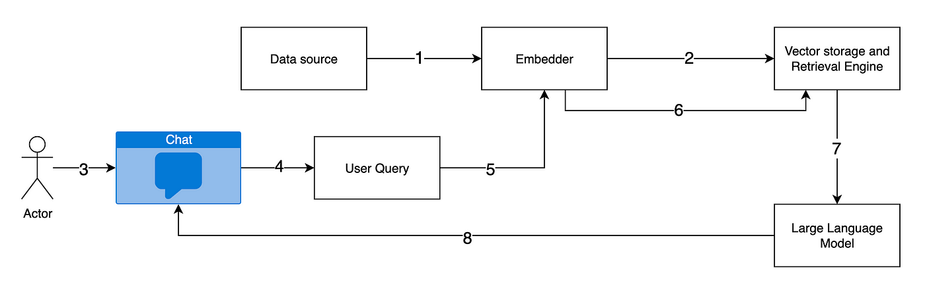

Slide 36
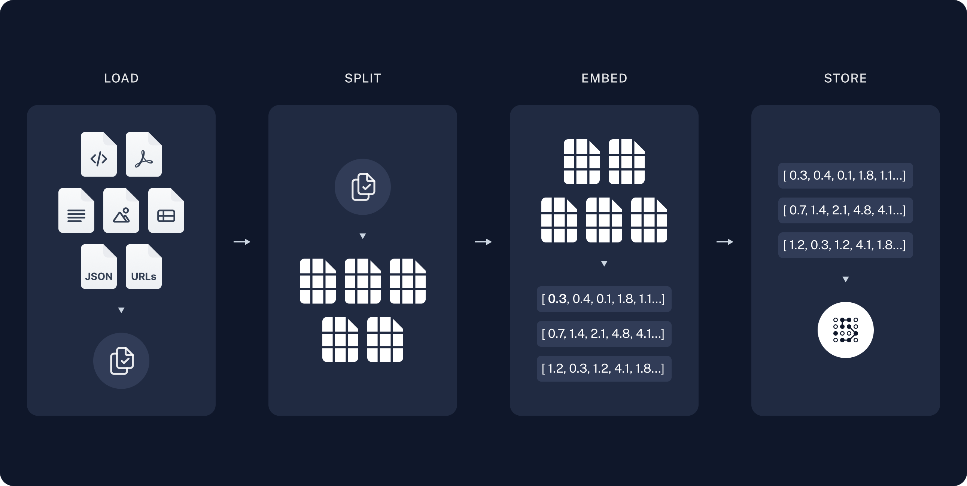
RAG

Slide 37
RAG Process
A typical RAG application has two main components:
Indexing: a pipeline for ingesting data from a source and indexing it. This usually happen offline.
Retrieval and generation: the actual RAG chain, which takes the user query at run time and retrieves the relevant data from the index, then passes that to the model.
The most common full sequence from raw data to answer looks like:
Indexing
Load: First we need to load our data. We’ll use DocumentLoaders for this.
Split: Text splitters break large Documents into smaller chunks. This is useful both for indexing data and for passing it in to a model, since large chunks are harder to search over and won’t fit in a model’s finite context window.
Store: We need somewhere to store and index our splits, so that they can later be searched over. This is often done using a VectorStore and Embeddings model.

Slide 38
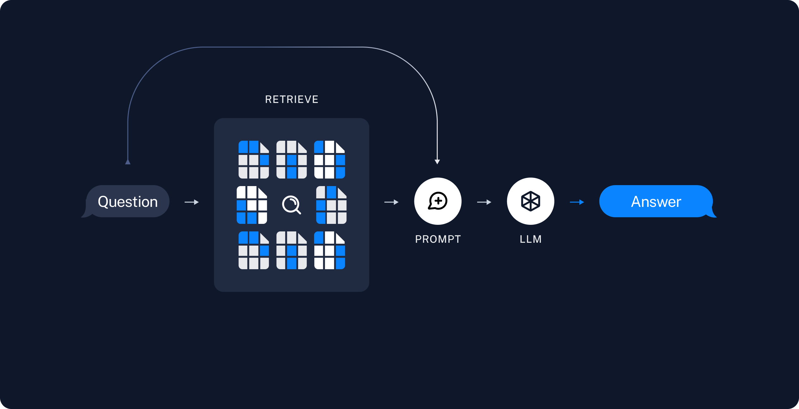
Retrieve & Generate
Retrieve: Given a user input, relevant splits are retrieved from storage using a Retriever.
Generate: A ChatModel / LLM produces an answer using a prompt that includes the question and the ret

Slide 39
Thank You

